Slide 1
Clustering
a bold adventure

Slide 2
Unsupervised Learning
OLS
GLM
Regression
KNN and RF reg.
Supervised
Logistic Regression
Classification
Trees
Machine Learning
SVM

Slide 3
Unsupervised Learning
OLS
GLM
Regression
KNN and RF reg.
Supervised
Logistic Regression
Classification
Trees
Machine Learning
SVM
Clustering
k-Means
Anomaly Detection
Hierarchical
Unsupervised
NN: auto-encoders
PCA

Slide 4
Unsupervised Learning
Supervised: Have a Y vector (Y₁ … Y_{n}) that we investigate using X vectors
Want to find P(Y|X)
Use cost function to represent errors, minimize loss
Unsupervised: No Y vector; use X vectors to explore structure of data
Investigating P(X)
Use / eff. of models depends on context
No clear measure of success

Slide 5
Unsupervised Learning
What do we use unsupervised learning for?
Data preprocessing / visualization
PCA
t-SNE
Clustering to find subgroups in structure of data (today’s lecture)

Slide 6
Clustering
Segment data into groups: similar in same group, dissimilar in different groups
What do we use clusters for?
EDA
Descriptive statistics:
Are clusters really different? E.g. medicine
Cluster characteristics -> e.g. different marketing
Features for further analysis

Slide 7
Clustering
Two problems:
What is ‘similar’ and ‘dissimilar’?
What is optimal number of clusters?

Slide 8
k-Means
Iterative clustering algorithm
Assign obs into clusters based on distance metric
(what kind of variables?)
Usual distance metric is Euclidean distance
d(x_{i}, x_{𝝁}) = √Σ_{i}^{n}(x_{i} - x_{𝝁})²
Some data better served by other metrics
E.g. cosine distance or Jaccard for text data
Broadly:
Iteratively find means of clusters based on distance
Assign obs to clusters based on distance to means
When new obs come in from test data, assign cluster based on distance from cluster mean

Slide 9
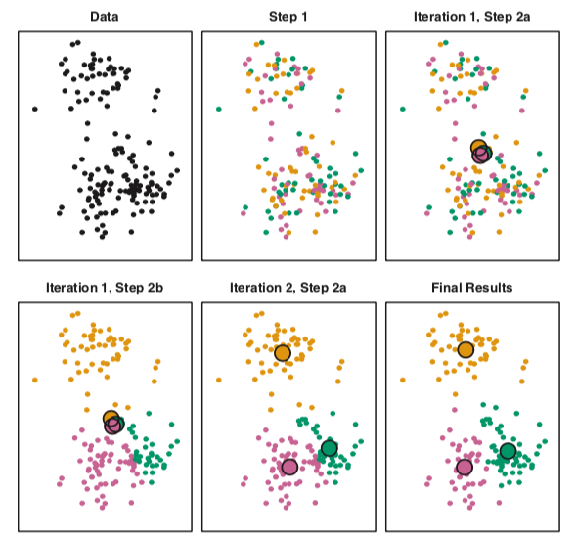
k-Means
X₂
How k-Means works:
X₁
X₁
X₁
Set # of clusters k, and randomly assign data to a cluster
X₂
X₁
X₁
X₁

Slide 10
k-Means
X₂
How k-Means works
(diagram is for data with two features, X₁ and X₂. For data with N features, this same operation is done in N-dimensional space):
X₁
X₁
X₁
Set # of clusters k, and randomly assign data to a cluster
X₂
X₁
X₁
X₁

Slide 11
k-Means
X₂
How k-Means works
(diagram is for data with two features, X₁ and X₂. For data with N features, this same operation is done in N-dimensional space):
X₁
X₁
X₁
Set # of clusters k, and randomly assign data to a cluster
X₂
(results sensitive to initial cluster selection; other methods exist besides ‘random’ for 1st assignment)
X₁
X₁
X₁

Slide 12
k-Means
2. Iteratively calculate cluster means
Find point in space which is the mean of each cluster (w/ Euclidean distance calcs)
For each obs, re-measure distance (w/ Euclidean distance calc) to each cluster mean; if obs is now closer to a new cluster mean, re-assign obs to that cluster
X₂
X₁
X₁
X₁
X₂
Repeat steps 2a and 2b until stopping point: no obs change clusters, means stop moving, etc
X₁
X₁
X₁

Slide 13
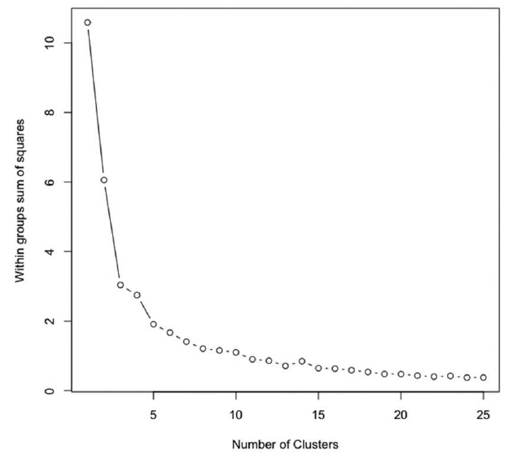
k-Means
How many clusters ‘should there’ be?
Not really dictated by data; dictated by situation in which we’re performing our analysis
Methods to ‘validate’ choice of k:
Re-initialize random seeding and run algo lotttttts of times; choose the k with the lowest avg distance from obs to cluster means
Our old friend the scree plot, from KNN and PCA, using within-group distance from obs to mean (easiest)
Silhouette score (most common)

Slide 14
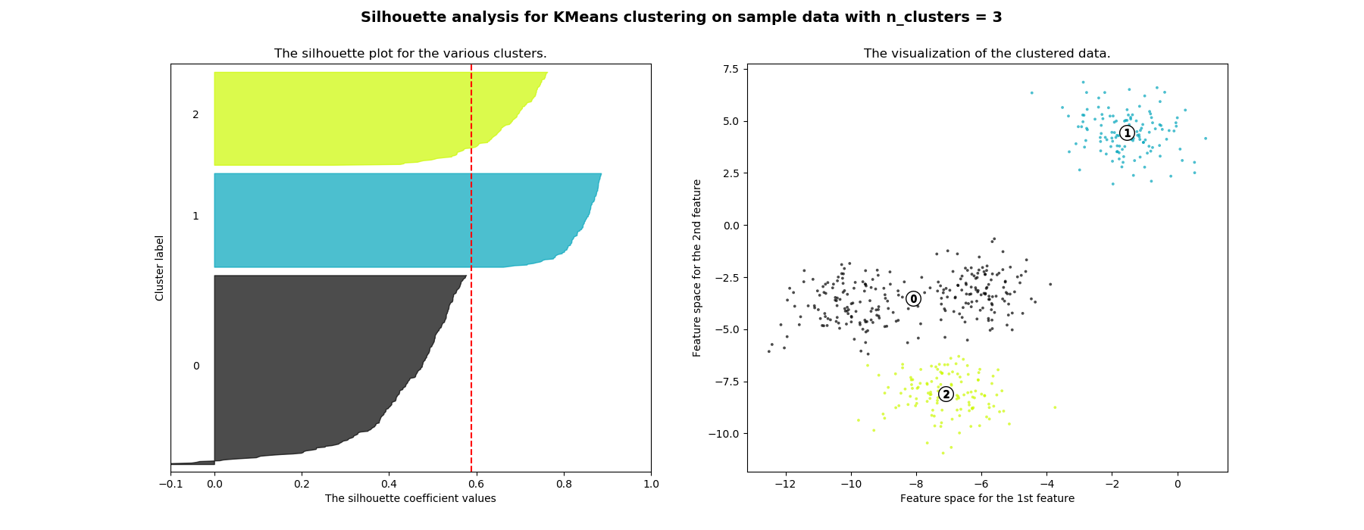
k-Means
Silhouette score:
For each obs, find distance from cluster mean. Graph for each cluster.
Interpret graph, and choose k based on the following criteria:
Values closer to 1 > values further from 1
Higher avg values > lower avg values (dashed line = avg)
All clusters relatively the same ‘thickness’ > different ‘thickness’

Slide 15
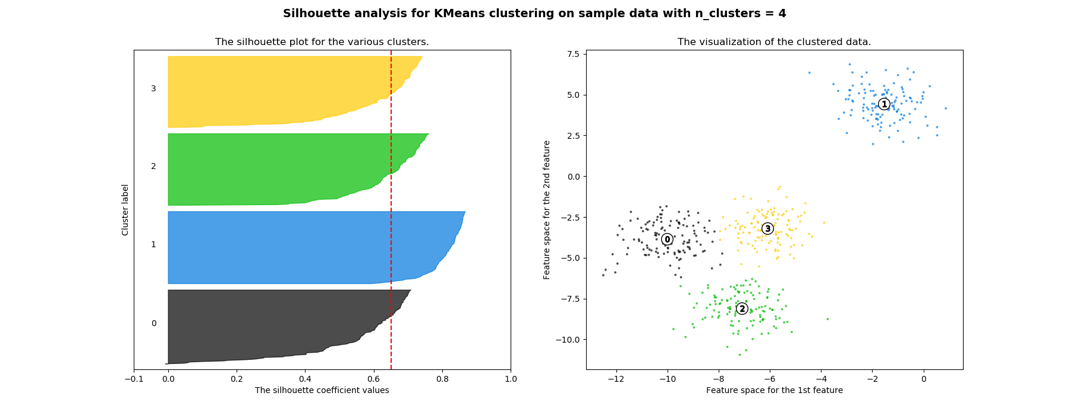
k-Means
Silhouette score:
For each obs, find distance from cluster mean. Graph for each cluster.
Interpret graph, and choose k based on the following criteria:
Values closer to 1 > values further from 1
Higher avg values > lower avg values (dashed line = avg)
All clusters relatively the same ‘thickness’ > different ‘thickness’

Slide 16
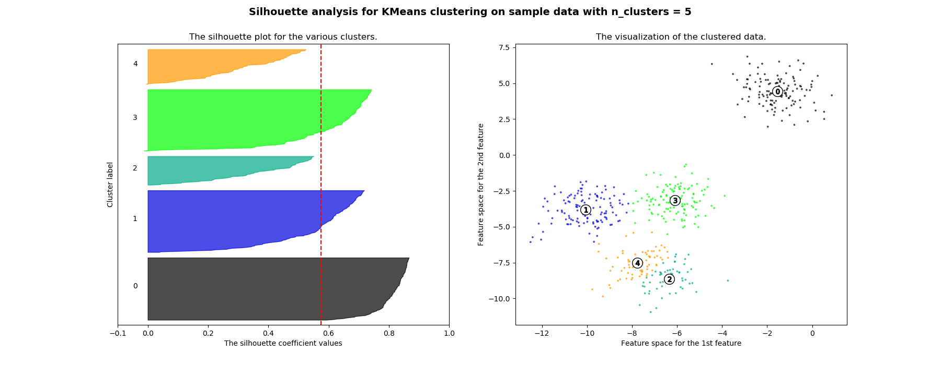
k-Means
Silhouette score:
For each obs, find distance from cluster mean. Graph for each cluster.
Interpret graph, and choose k based on the following criteria:
Values closer to 1 > values further from 1
Higher avg values > lower avg values (dashed line = avg)
All clusters relatively the same ‘thickness’ > different ‘thickness’

Slide 17
k-Means
Real-world uses:
Customer segmentation - group customers to find different promotional opportunities
(eg eggs + disinfectant + phone cords = pregnant)
Waste / fraud / abuse
Clustering customer complaints
Text docs (eg http://scikit-learn.org/stable/auto_examples/text/document_clustering.html)

Slide 18
k-Means
Other considerations
Scaling? Eh
If already all on same scale, don’t re-scale
Sometimes re-scaling distorting (large but skinny geographical area)
Traditional use case of scaling - height in in., weight in lbs. - good candidate for scaling w/ k-Means
Remember: continuous data, not categorical

Slide 19
k-Means
Other considerations
Remember: converges to local minima, not global
Can be slow, but mini-batch can speed it up
Interview ?s:
Diff b/t supervised and unsupervised learning?
What are some types of unsupervised learning?
What are some use cases of clustering algos?
How does k-Means algo work?
What are some disadvantages?
How can it be sped up?

